Slide 1

Welcome & Module Induction
What we learned previously: In Module 2, we secured our "ingredients." We learned how to lock down dependencies using strict versions and cryptographic hashes, ensuring our environment builds perfectly on any server or lab machine.
What we are learning today: Now, we focus on the code itself. We are transitioning from writing "code that merely works" to writing "code that is industrially acceptable." We will cover the official Python style guide (PEP 8), Automated Linters, and Auto-Formatters.
Why this will be helpful: When you apply for a Master's program, contribute to open-source vision frameworks, or publish research alongside academic papers, reviewers will judge your code's quality before they even look at your logic. Messy formatting can cause your work to be dismissed immediately. Today, you will learn how to automate these standards so your code always looks like it was written by a senior engineer.

Slide 2
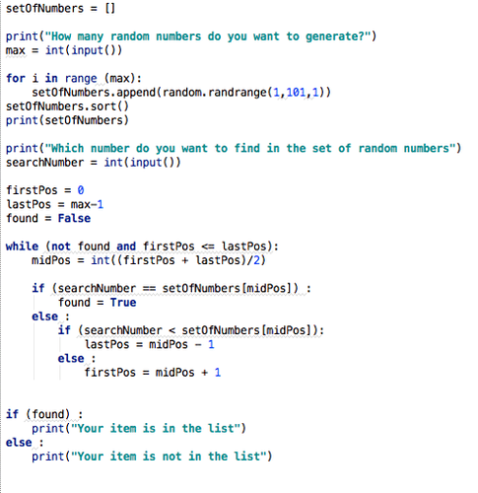
PEP 8 & The Cost of "Ugly" Code
The Standard: PEP 8 is the universal style guide for Python. It dictates how to name variables, how many blank lines to use, and where to put spaces.
The Problem: Memorizing every rule is inefficient and prone to human error.
The Goal: Write code that is universally readable by any other Python developer instantly.

Slide 3
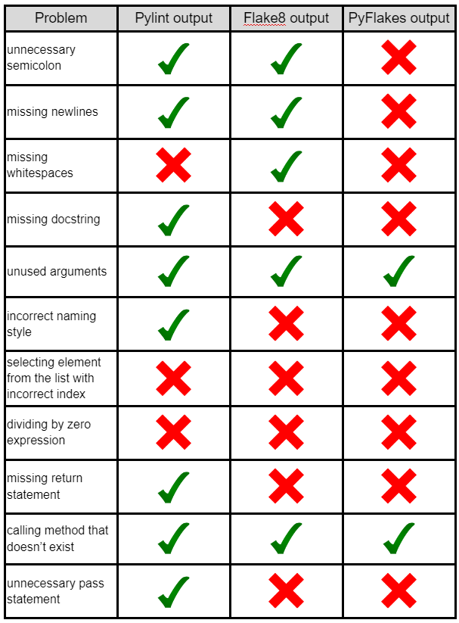
Automated Linters (Flake8 & Pylint)
What is a Linter? Think of it as a strict spell-checker for logic and style.
How it works: It performs static analysis. It reads your code without running it and flags stylistic errors, undefined variables, and overly complex functions before you even hit "execute."

Slide 4
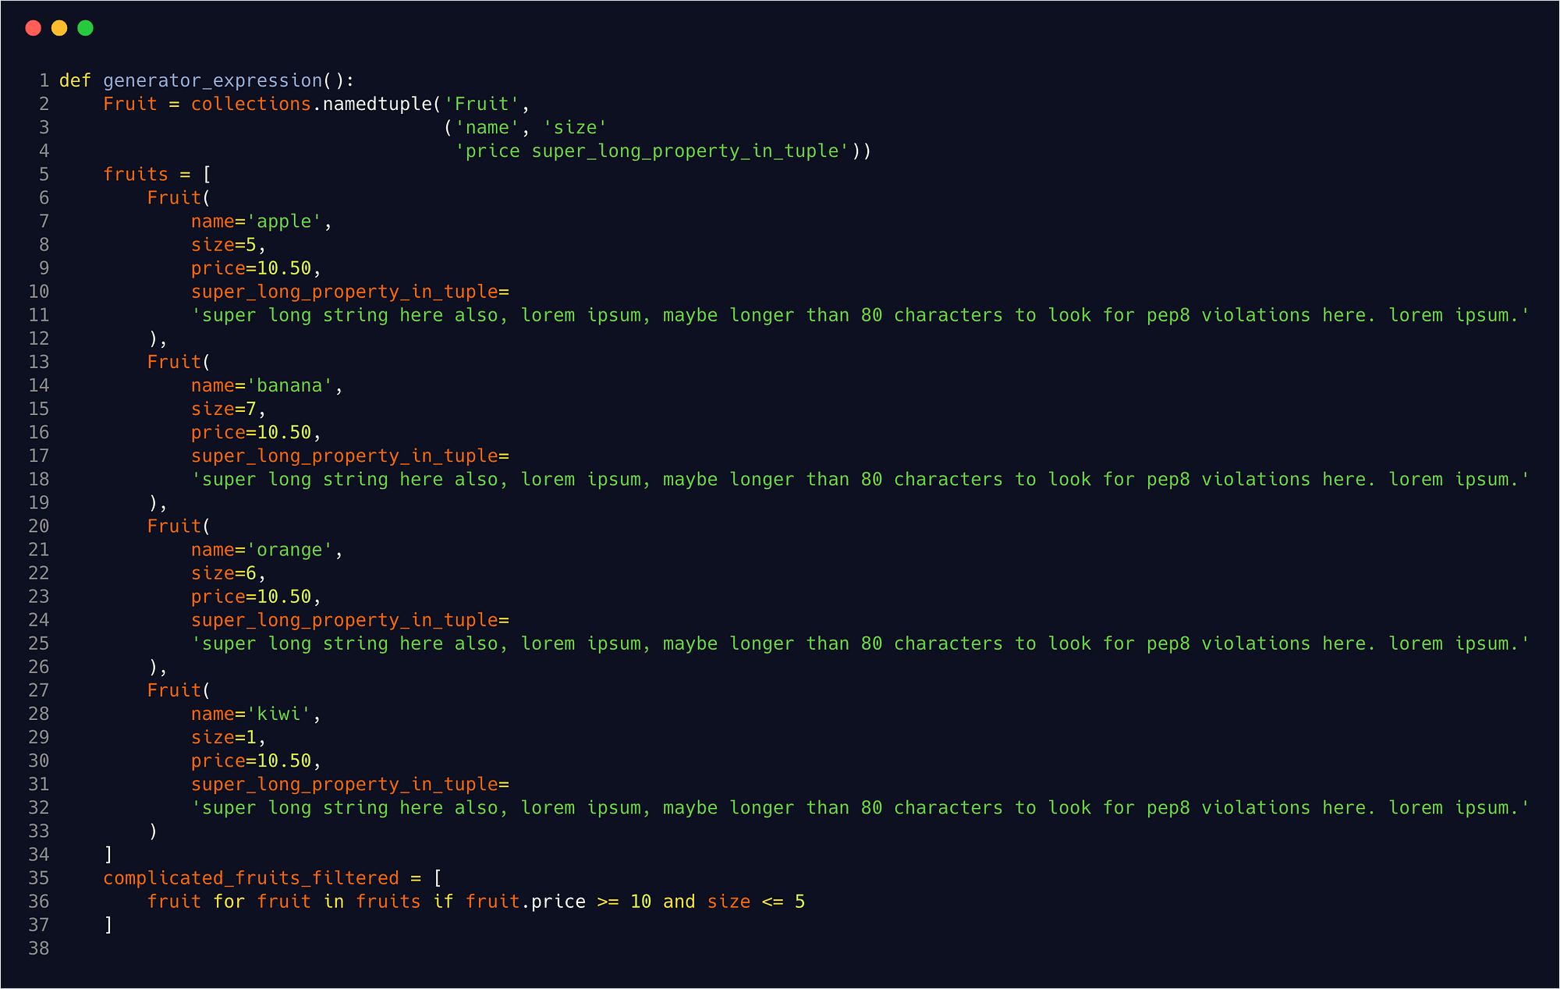
The "Senior Engineer" Button: Auto-Formatters
Finding vs. Fixing: Finding errors with a linter is great, but fixing them manually wastes time.
isort: Automatically groups and alphabetizes your imports at the top of the file so they look organized.
Black: Known as the "uncompromising code formatter." It takes your messy code, breaks it down, and completely rewrites it to perfect PEP 8 standards in milliseconds.

